Slide 1

Session
Gizmo
Sentiment Analysis in Returns Predictions
1
Notes:
https://unsplash.com/photos/m5P0c6ABWDs

Slide 2



Session
Investment strategies may be significantly improved by factoring public sentiment of financial performance.
To test our hypothesis, we develop a trading tool that accounts for public sentiment from Tesla (TSLA) and market trends in the investment strategy, to determine whether it improves trading returns.
An ambitious objective
2
Notes:
https://unsplash.com/photos/KqVHRmHVwwM
https://unsplash.com/photos/1trRa_xcEHE

Slide 3






Session
The dream team
Edward Arnold
Joe Malinovsky
Alejandra Torres
Session Mwamufiya
3
Notes:
https://unsplash.com/photos/KqVHRmHVwwM
https://unsplash.com/photos/1trRa_xcEHE

Slide 4
Session
Our game plan was simple and well structured
1 Data
2 Baseline
Obtain TSLA stock and market sentiment data over the same time period, and apply pre-processing techniques
Create an investment strategy using an ML classifier on stock data
3 Analysis
4 Evaluation
Apply a sentiment analysis classifiers to develop alternative investment strategies
Compare the performance of the strategies and determine future improvements
4

Slide 5
Alejandra
We benefited from some tailwinds …
The team was highly motivated and excited to work together
1
We relied on existing work from prior challenges to build our baseline
2
Our Ups
We leveraged a sentiment analysis solution on YouTube to develop ours
3
5

Slide 6
Alejandra
Our Downs
Difficult to find enough relevant sentiment data for TSLA
1
Sentiment data required significant manipulation before it could be used
2
Time was not on our side…
3
… and encountered some headwinds
6

Slide 7
Edward
In the end there was little improvement!
SVC
With a short window of 7 days and a long window of 60 days, our strategy was a little better than a coin toss
53%
Out attempted model adjustments, including sentiment analysis, did not provide significantly better results than the baseline
Applying sentiment analysis to the SVC classifier provided the exact same result as without
53%
LDA
Baseline
Adjusting to a Linear Discriminant Analysis (LDA) classifier, with sentiment analysis, reduced the accuracy of the model due to dimension reduction
48%
7

Slide 8

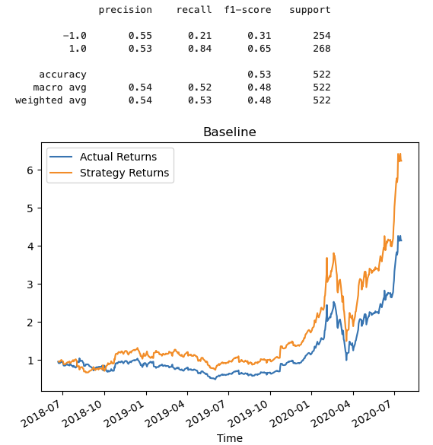


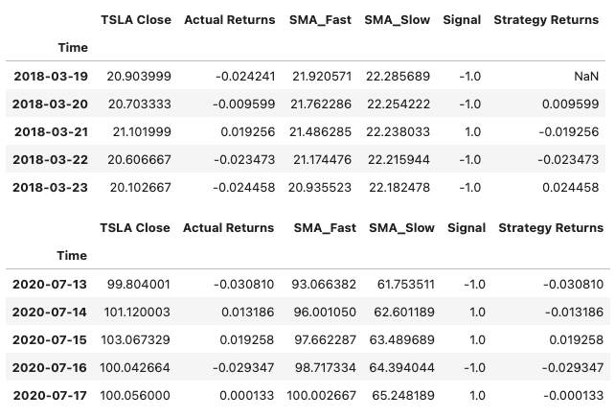
Edward
We went through the grind …
Short Window
Long Window
SVC Classifier
8

Slide 9

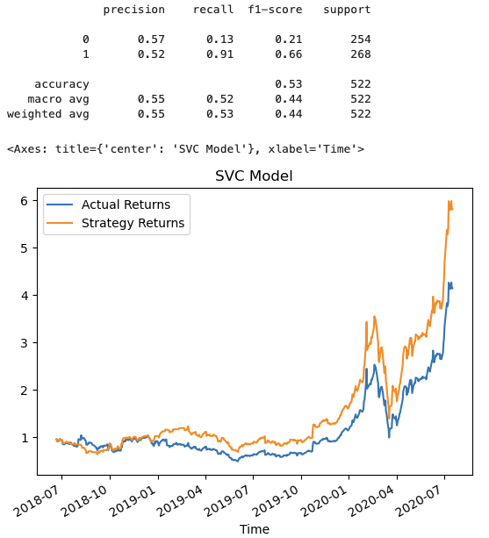


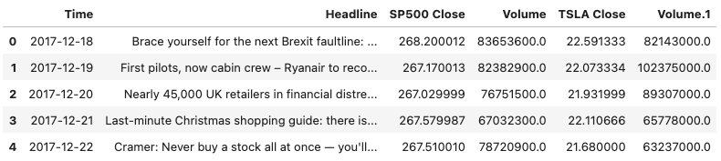
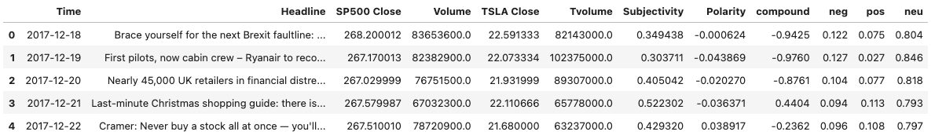

Alejandra
We went through the grind …
textBlob
SVC Classifier
vaderSentiment
9

Slide 10
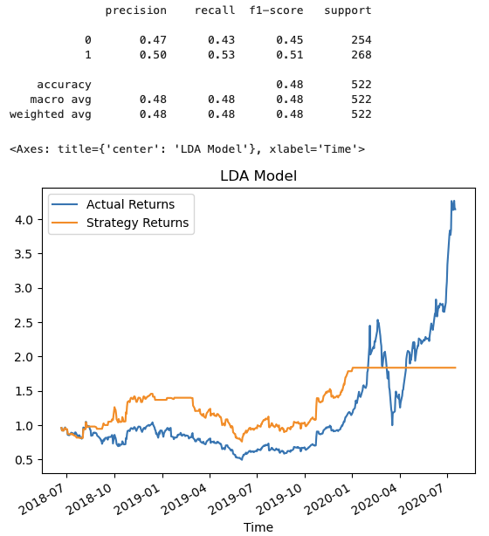
Joe
We went through the grind …
textBlob
LDA Classifier
vaderSentiment
10

Slide 11
Joe
There is more to be done …
Obtain additional relevant data: The LDA classifier likely failed to produce a better result due to insufficiency of sentiment data
Expand experimentation:
Limited time constrained the variability of options we could have tried (e.g., feature selection changes, timeframe offsets, etc.)
Explore impactful correlations:
Trial and error is time consuming and leads to frustration when results don’t improve
11

Slide 12

Thank you
Notes:
https://unsplash.com/photos/B6yDtYs2IgY

